Slide 1
GIS @ VTrans
JOHNATHAN – NINA – STEPHEN vtrans.github.io/chester-hs/

Slide 2
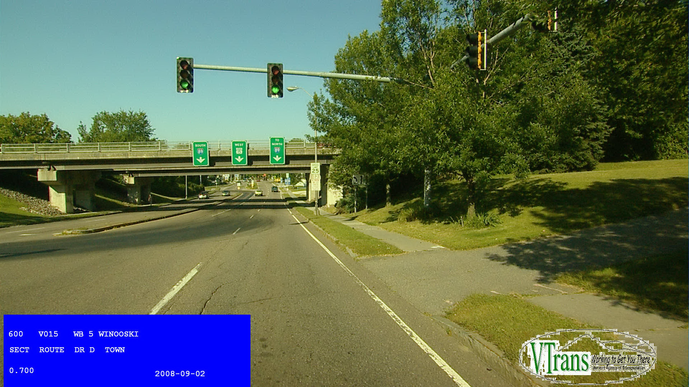
VTrans – Projects In the Mapping Section Vermont Agency of Transportation Policy, Planning & Intermodal Development Division Mapping Section

Slide 3
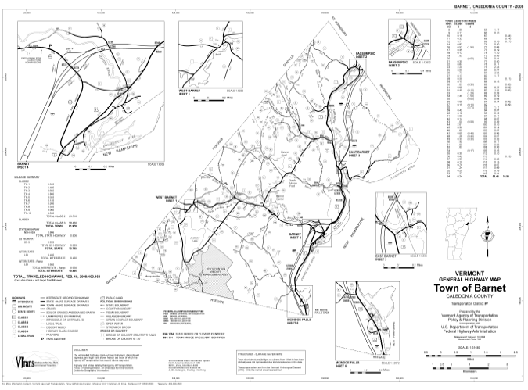
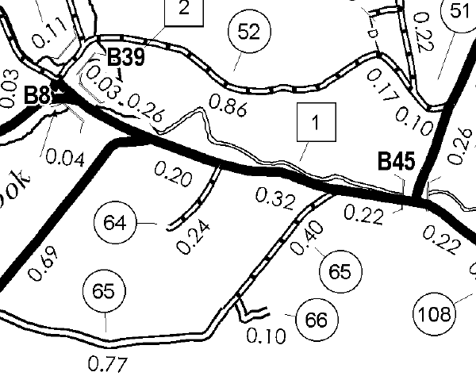
Town Highway Maps & Mileage
http://vtransplanning.vermont.gov/maps

Slide 4
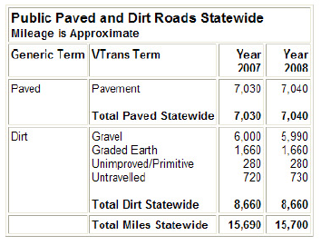
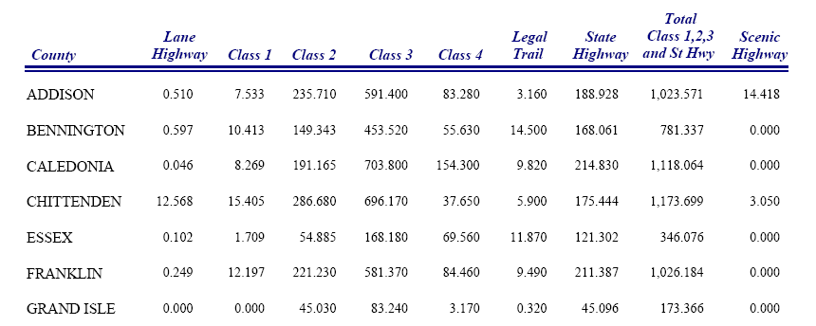
Town Highway Maps & Mileage
Production of the Mileage Summaries
Mileage data used in formula for appropriation for State Aid for Town Highway maintenance
Mileage used in local Vehicle Miles Traveled calculations
http://vtransplanning.vermont.gov/maps/stats
http://vtransplanning.vermont.gov/maps/publications

Slide 5
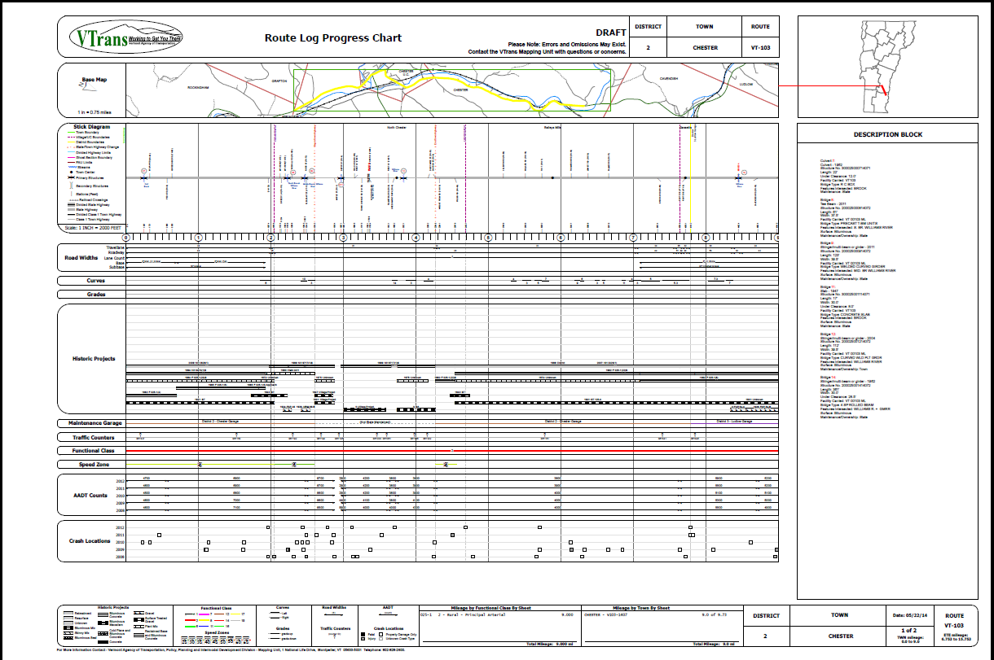
Route Log System
http://vtransplanning.vermont.gov/maps/routelogs

Slide 6
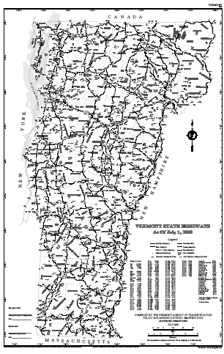
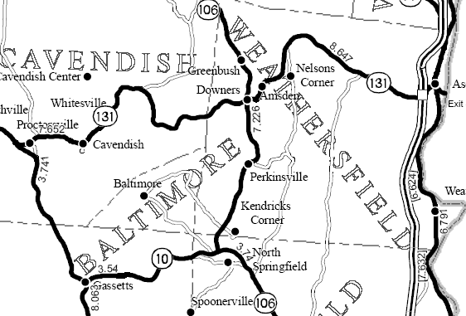
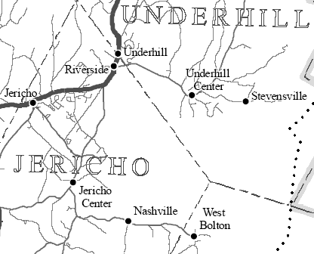
Map Production
Map No. 1 & State Highway Map

Slide 7
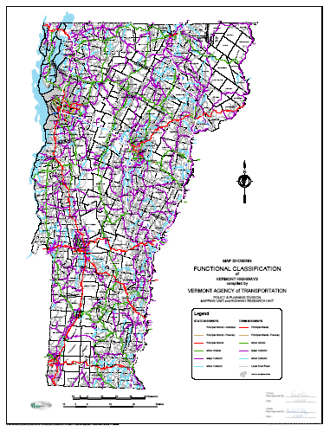
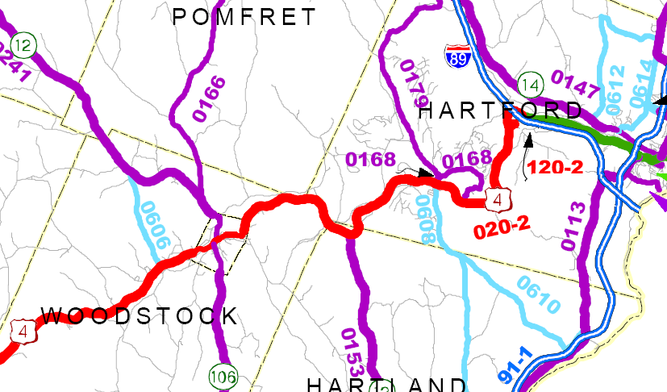
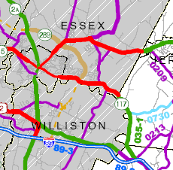
Rural Functional Class Map
http://vtransplanning.vermont.gov/sites/aot_policy/files/documents/highwayresearch/RuralFunclStatewide_2013.pdf

Slide 8
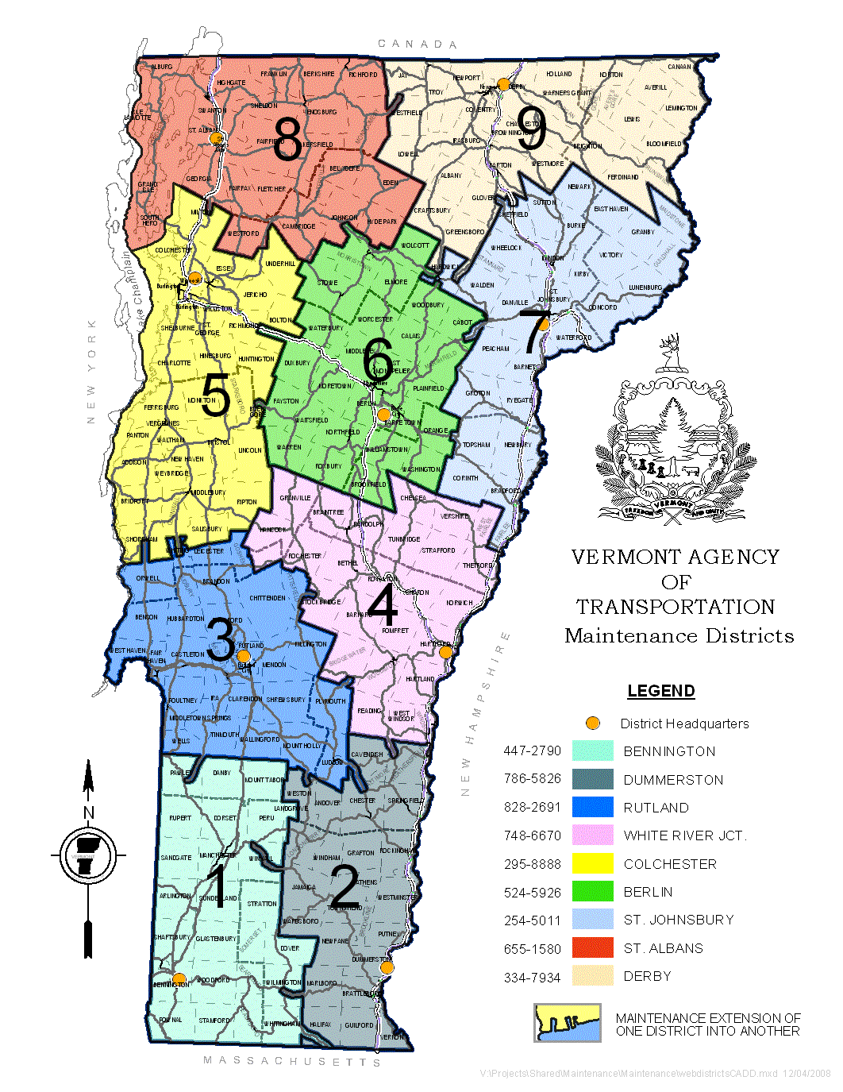
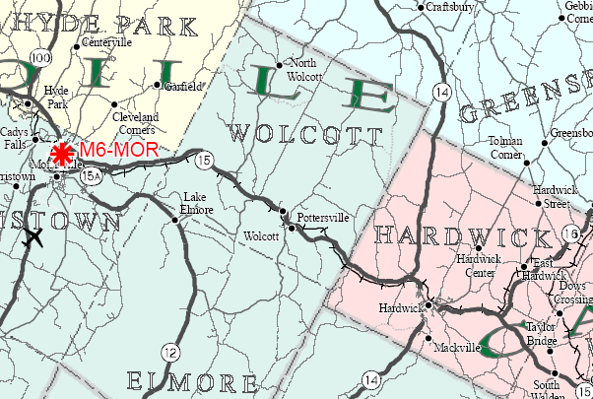
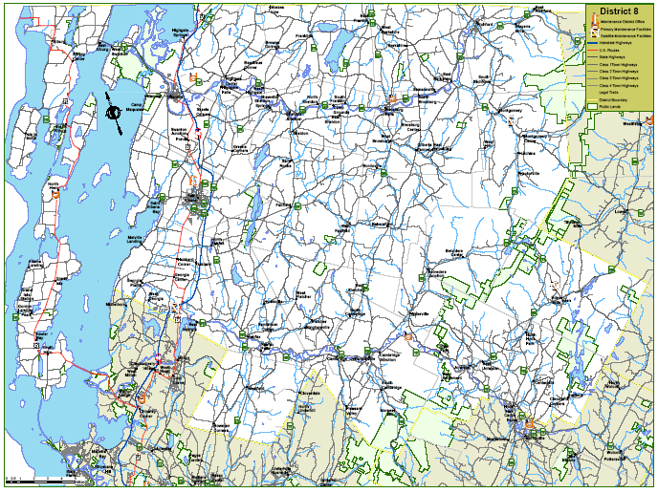
District Maps

Slide 9
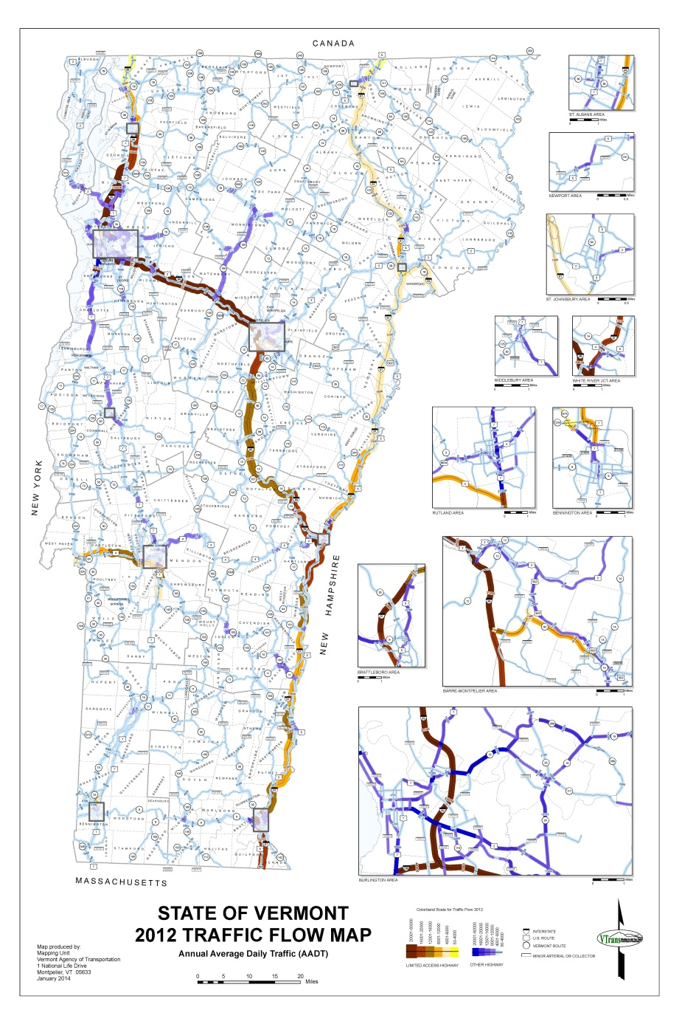

2012 Traffic Flow Map

Slide 10
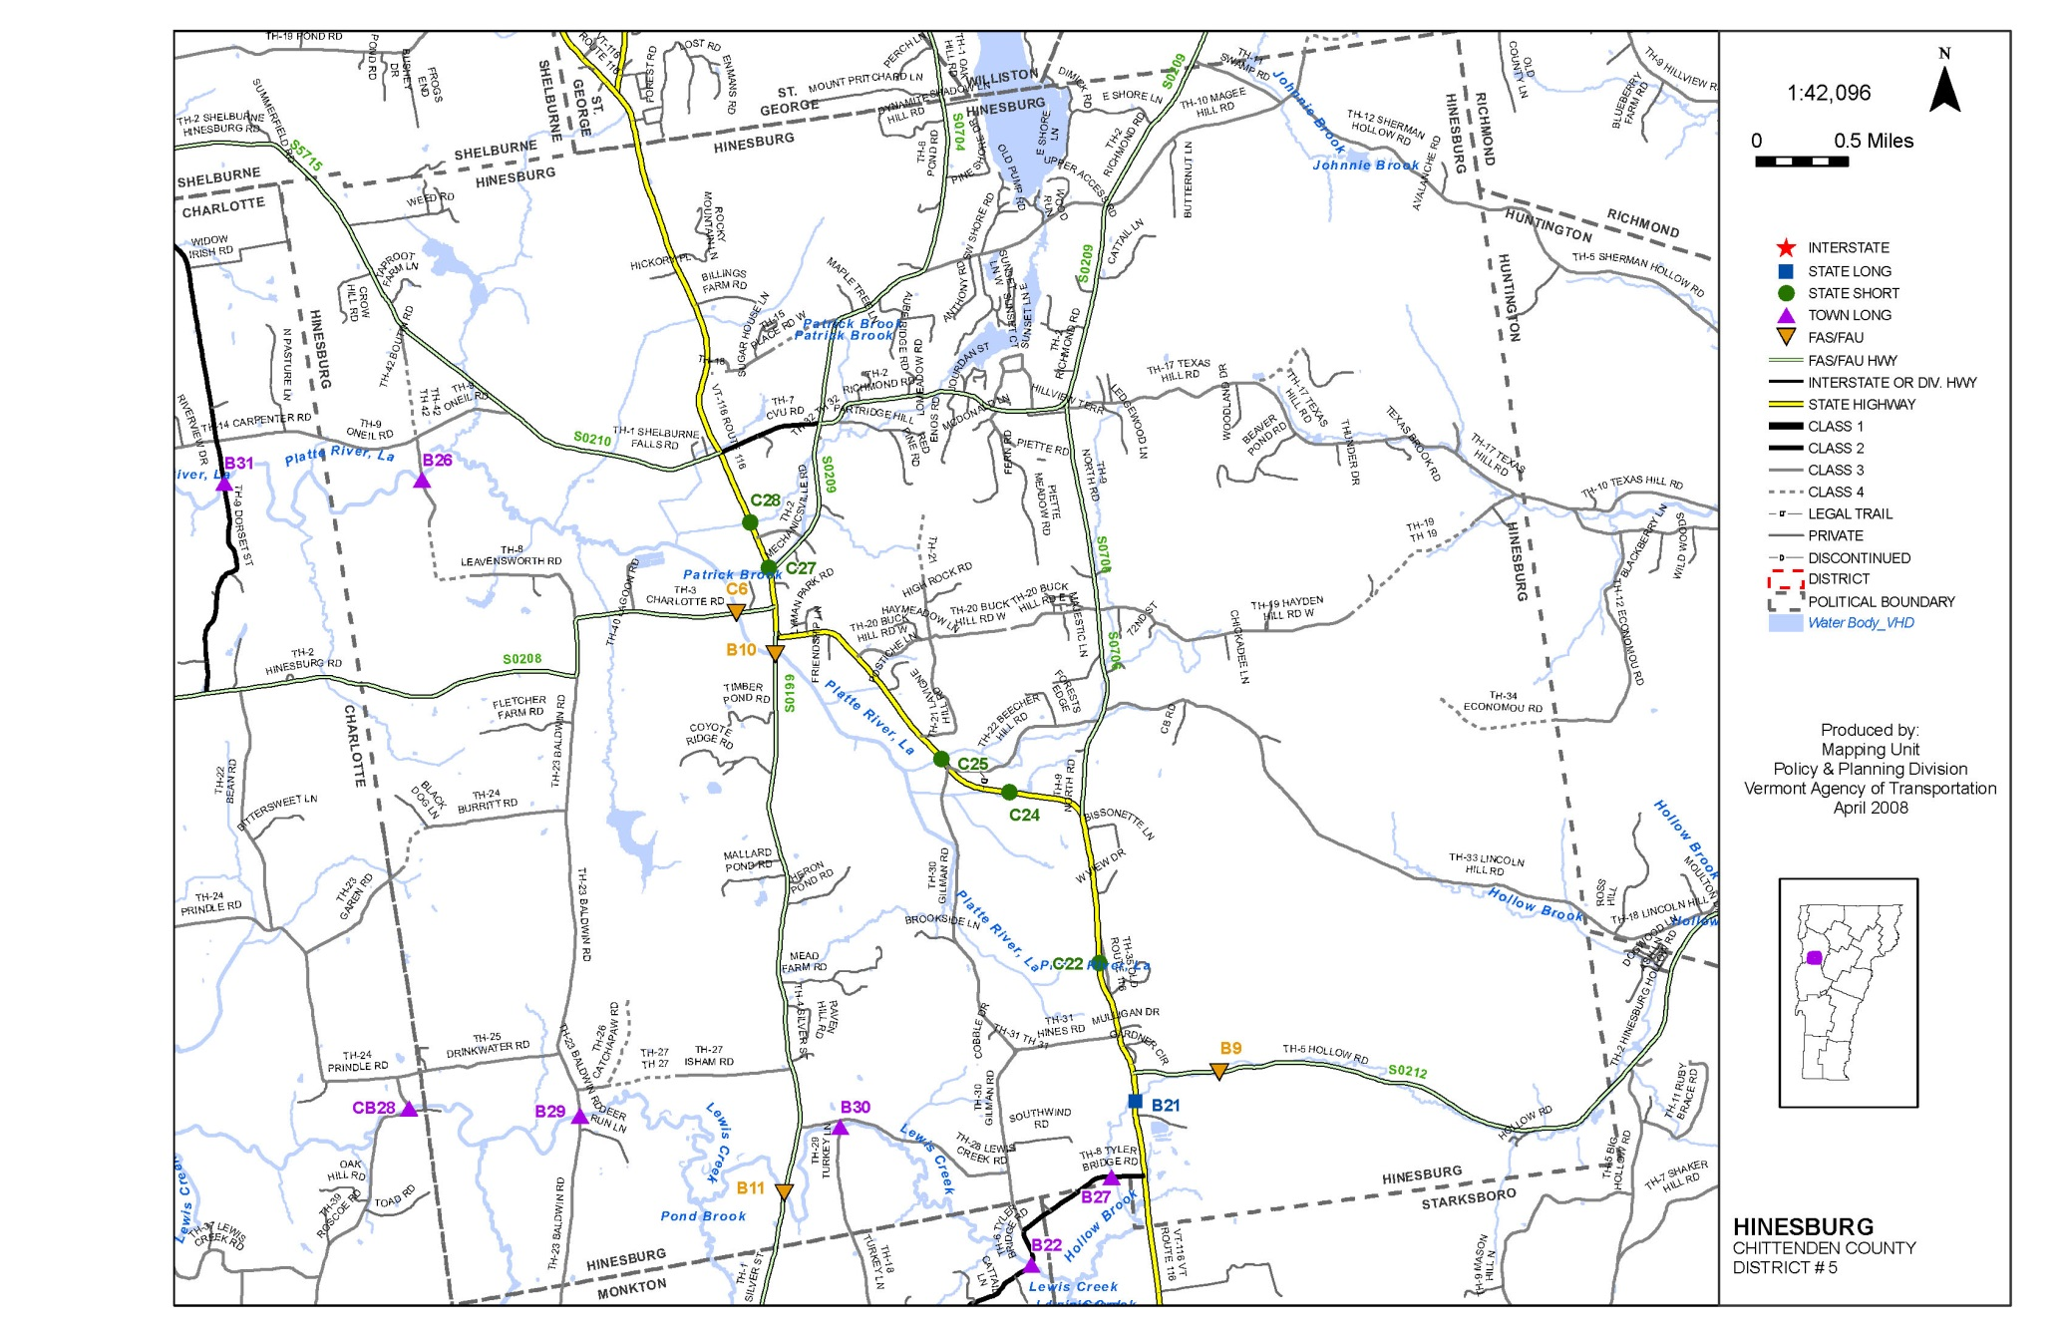
Bridge Inventory Maps

Slide 11
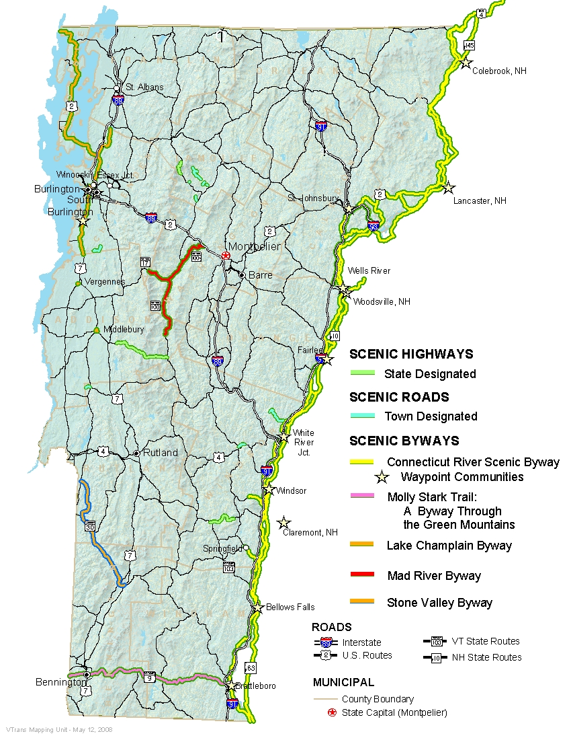
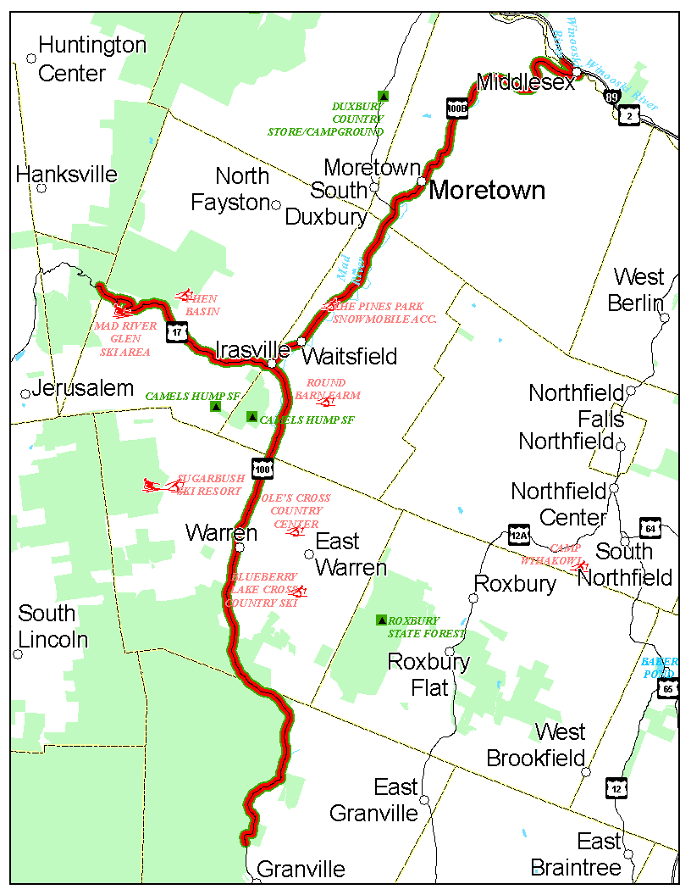
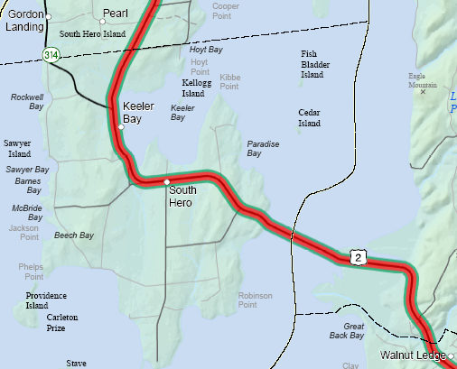

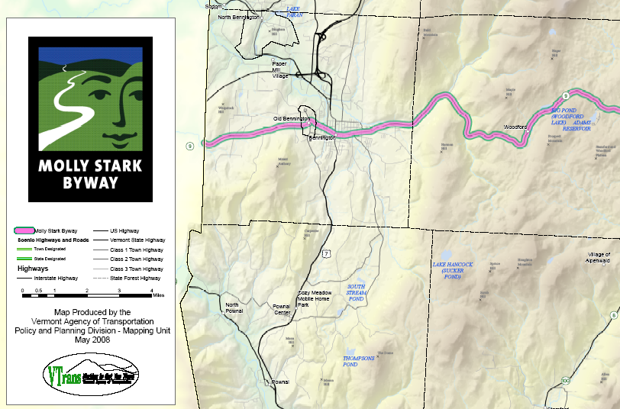
Scenic Byway Maps
http://www.vermont-byways.us/

Slide 12
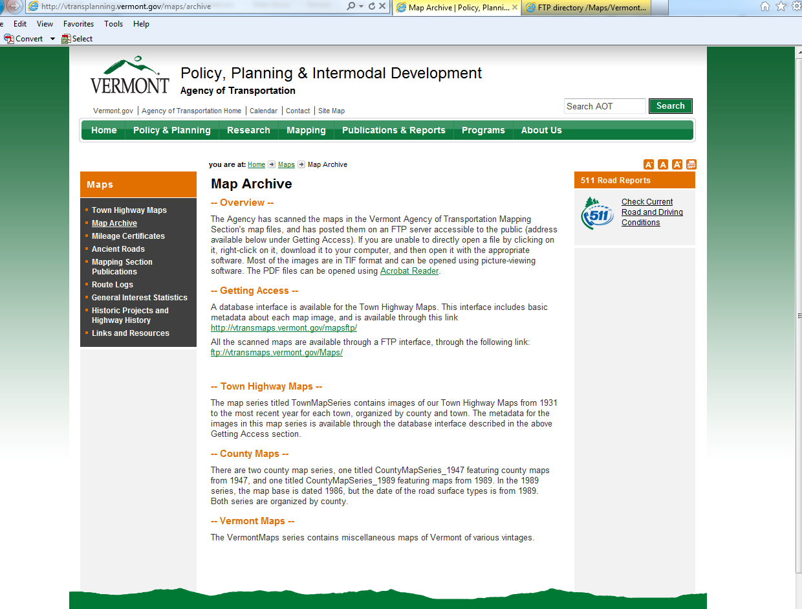
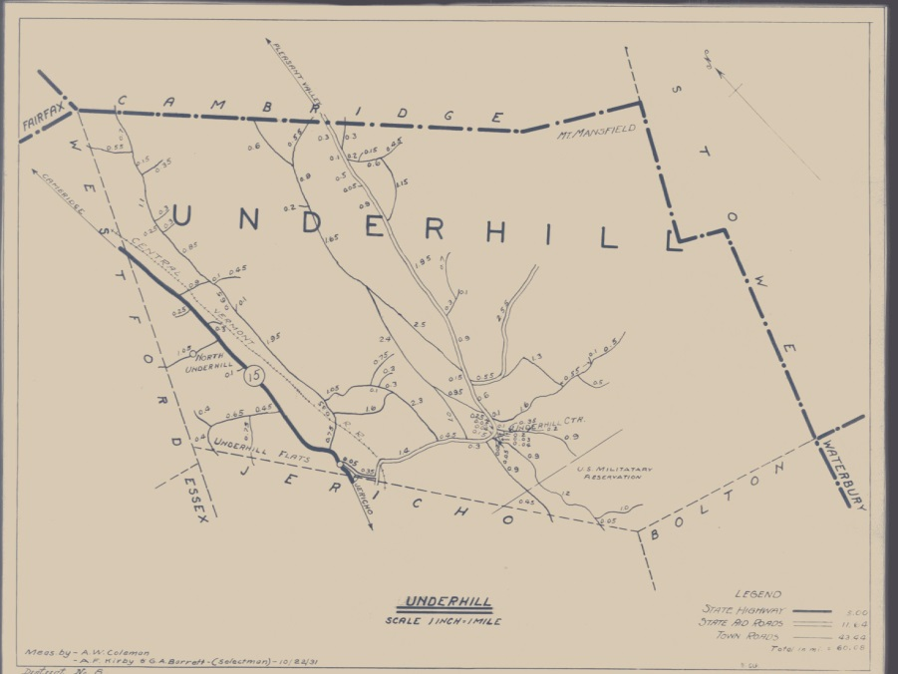
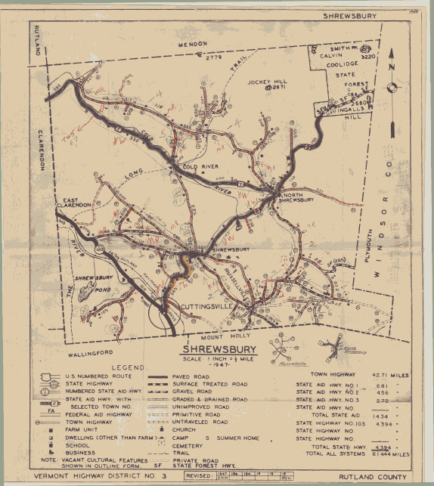
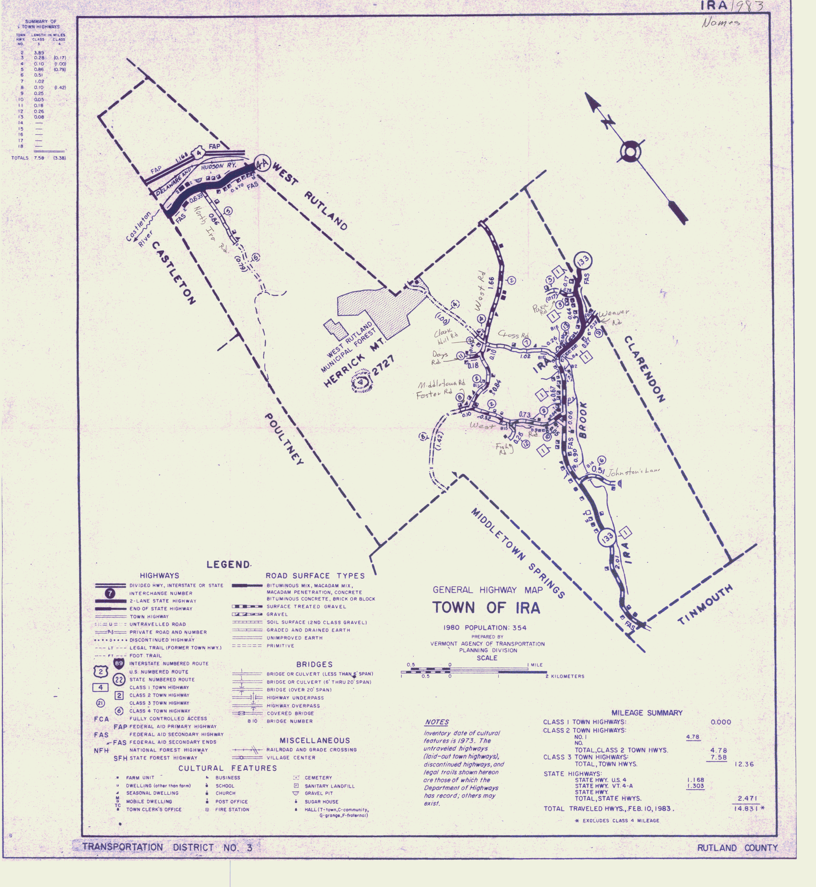
Map Archive
http://vtransplanning.vermont.gov/maps/archive

Slide 13
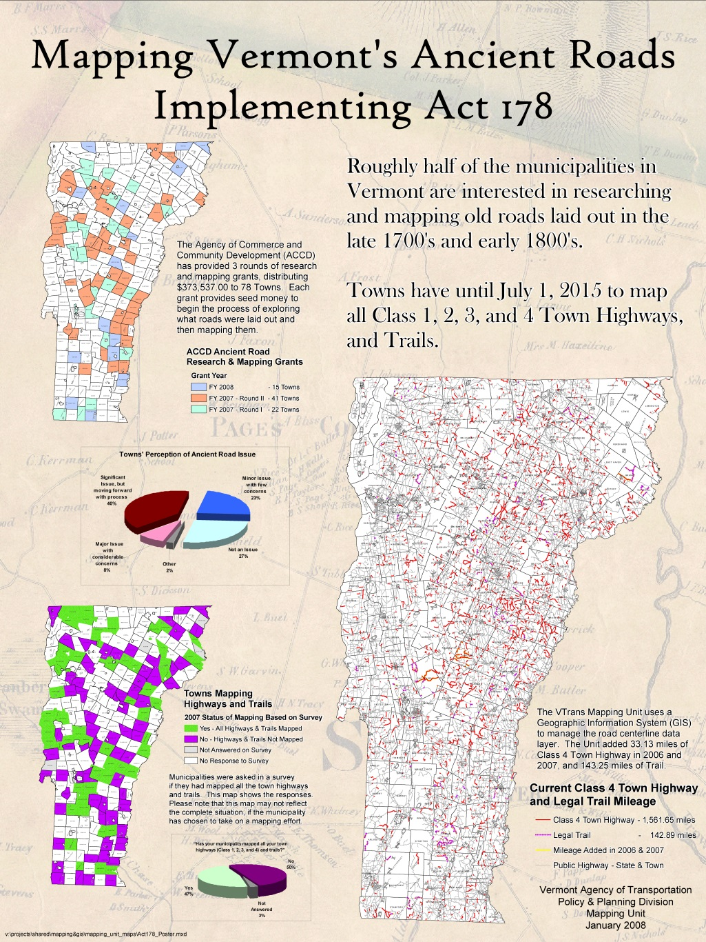
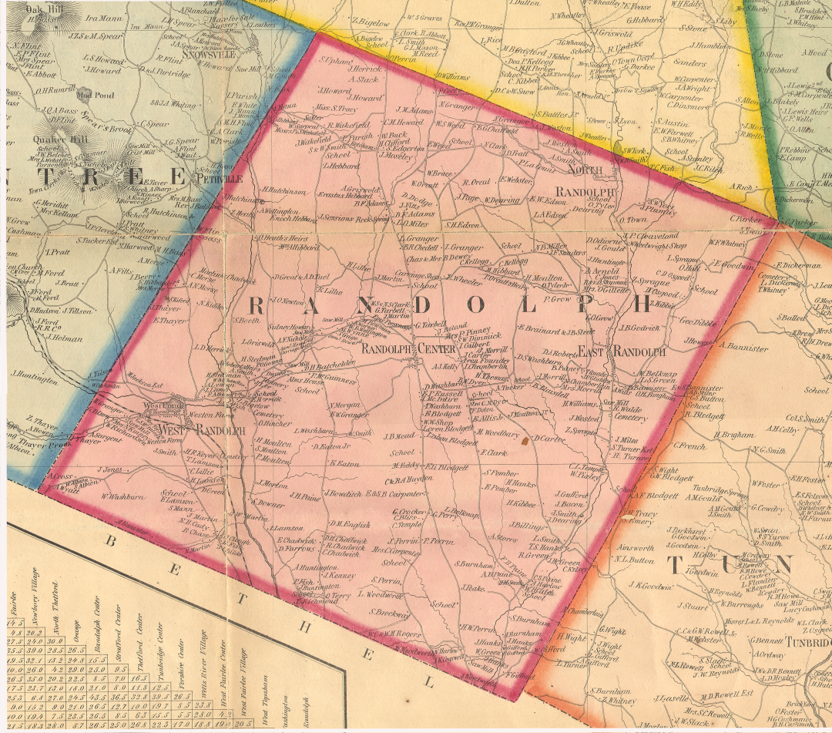
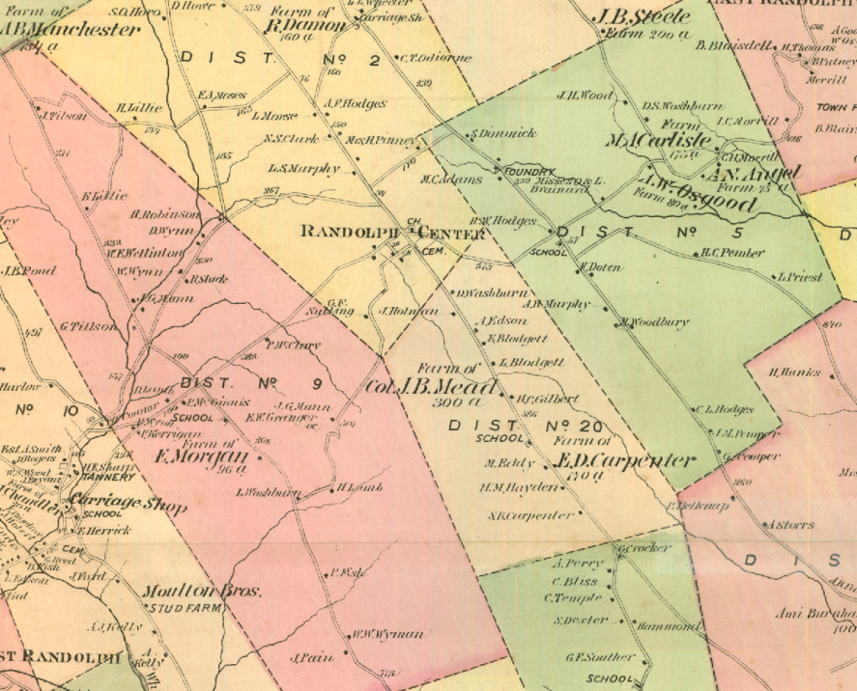
Act 178 - Ancient Roads

Slide 14
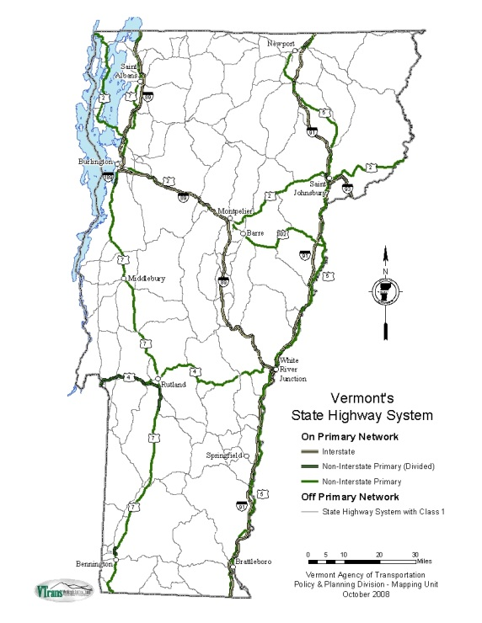
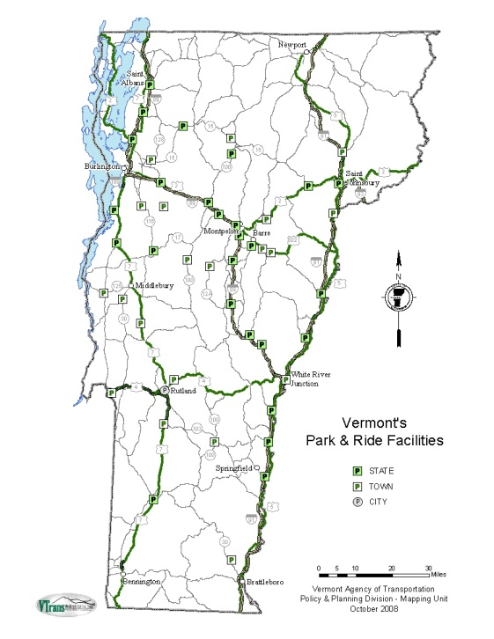
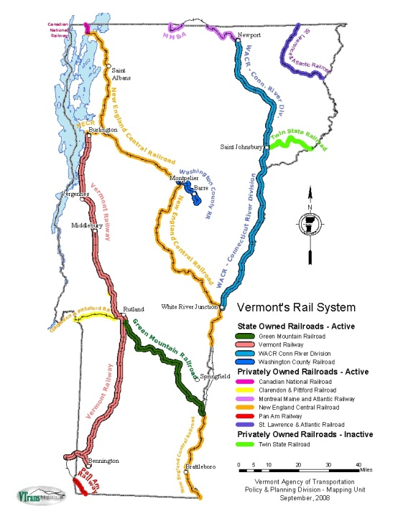
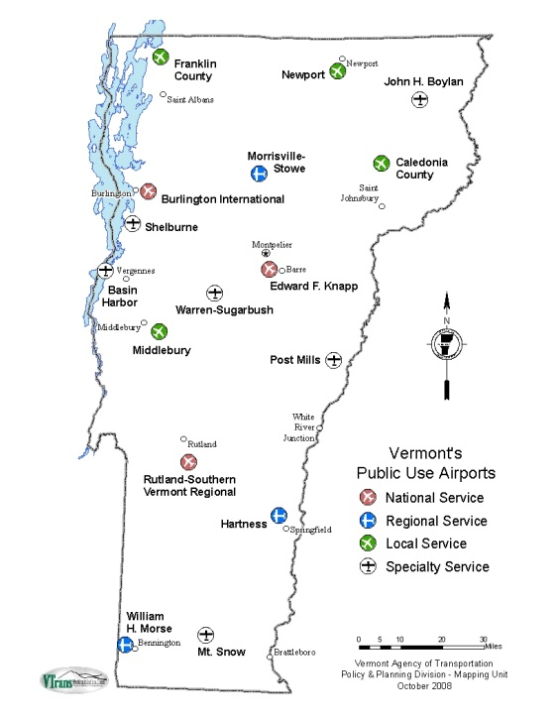
Long Range Transportation Business Plan Maps

Slide 15
Special Projects

Slide 16

Questions???
Johnathan Croft
VT Agency of Transportation
Policy, Planning & Intermodal Development Division
Mapping Section
(802) 828-2600
johnathan.croft@state.vt.us

Slide 17
VTrans Surveying
NINA SAFAVI SURVEY & GIS PROJECT MANAGER NINA.SAFAVI@STATE.VT.US
vtrans.github.io/chester-hs/

Slide 18
NINA - BACKGROUND
ECONOMICS
DESIGN
SURVEY

Slide 19

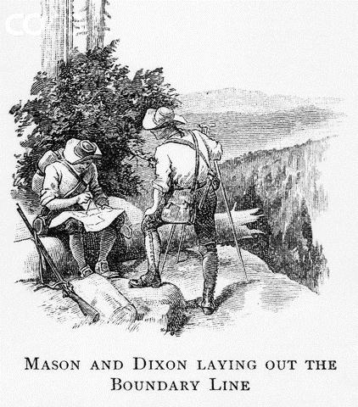
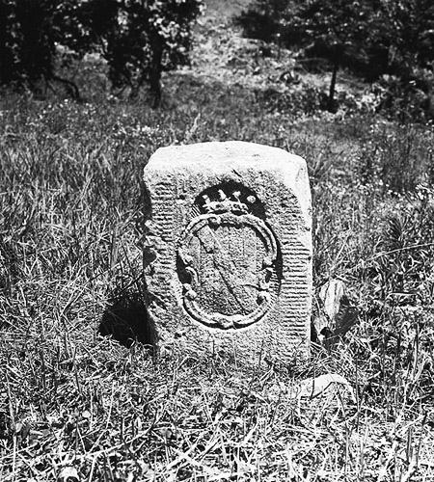
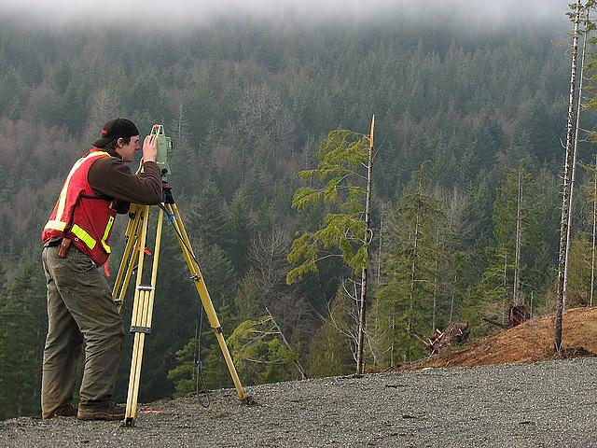
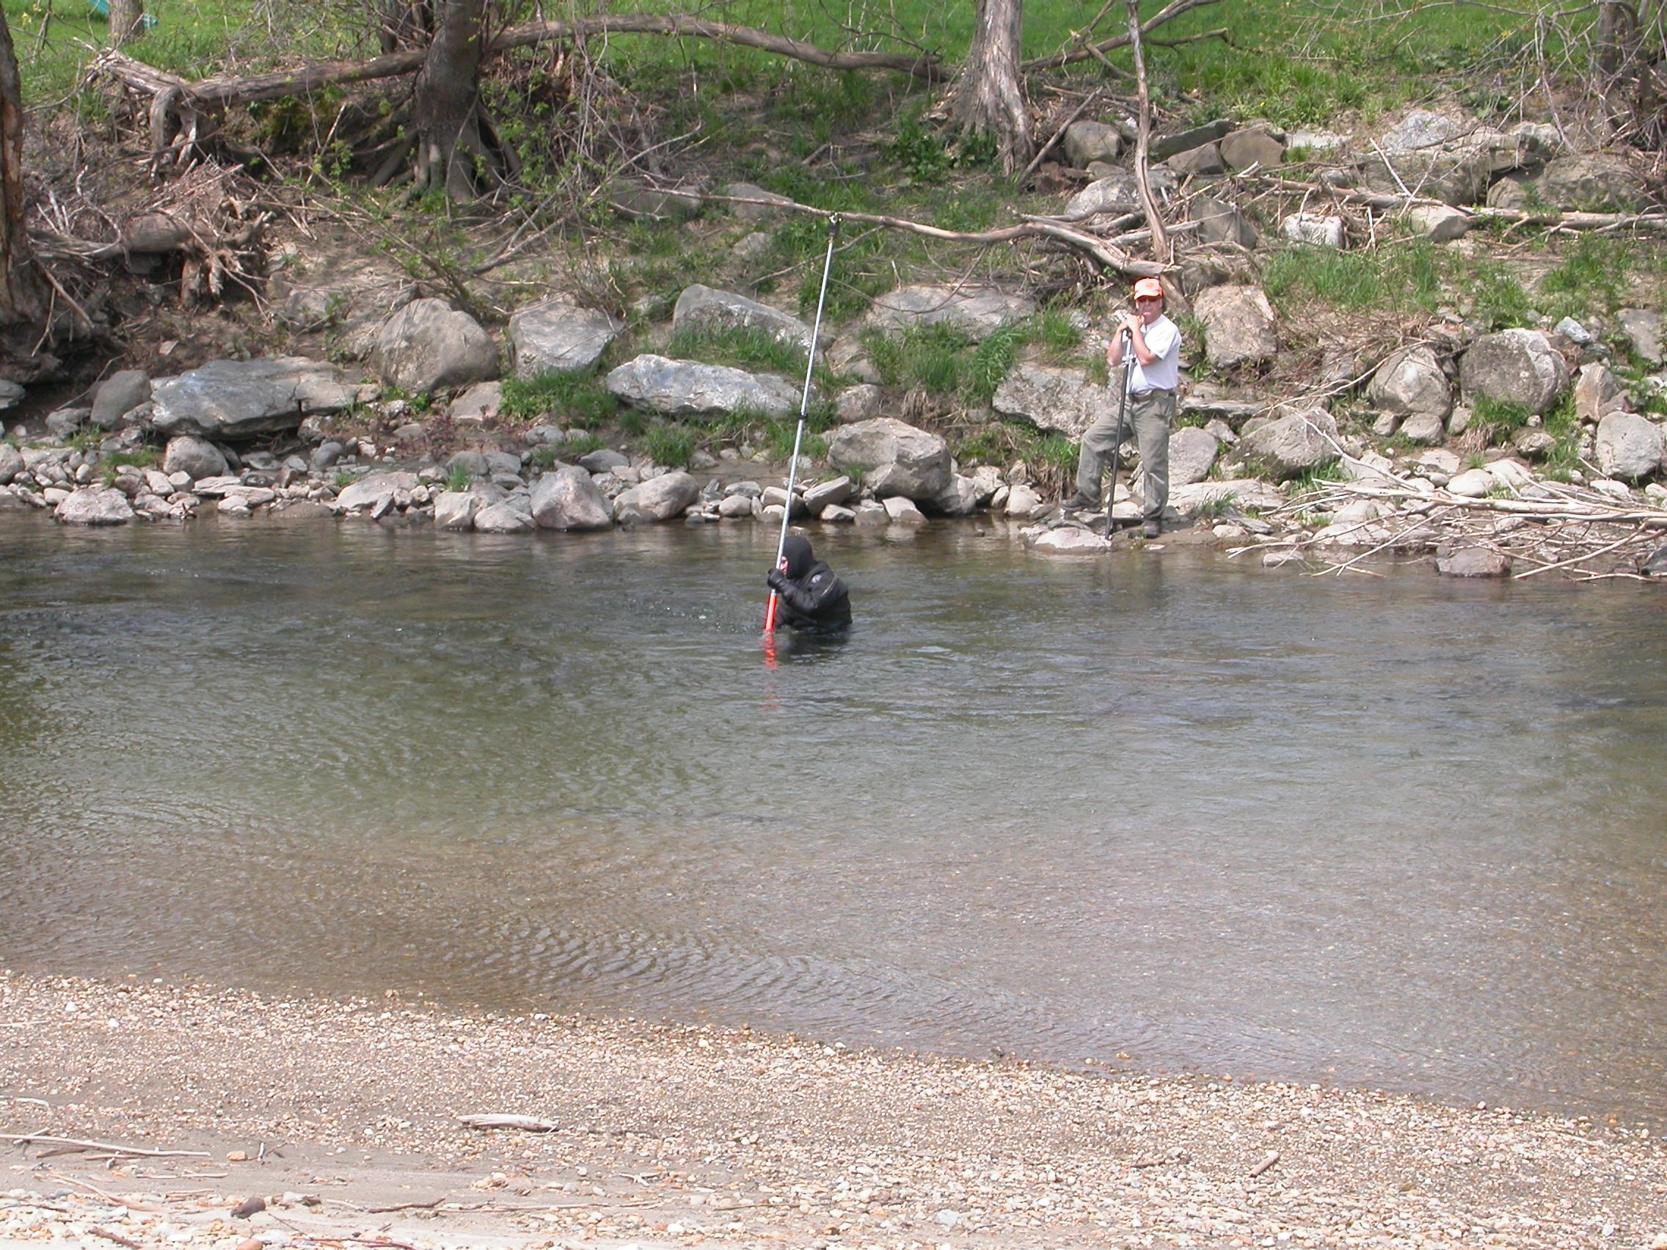

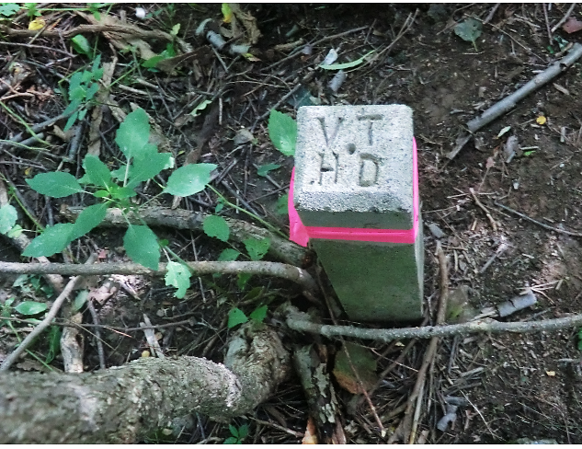
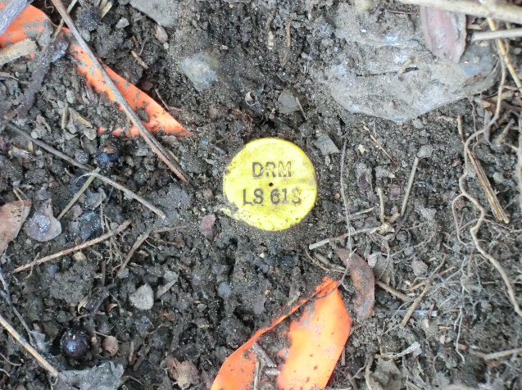

SURVEYING

Slide 20
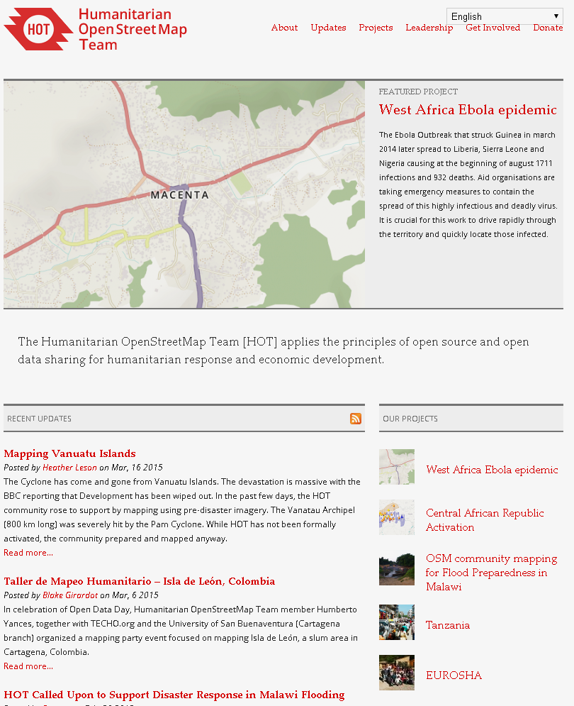

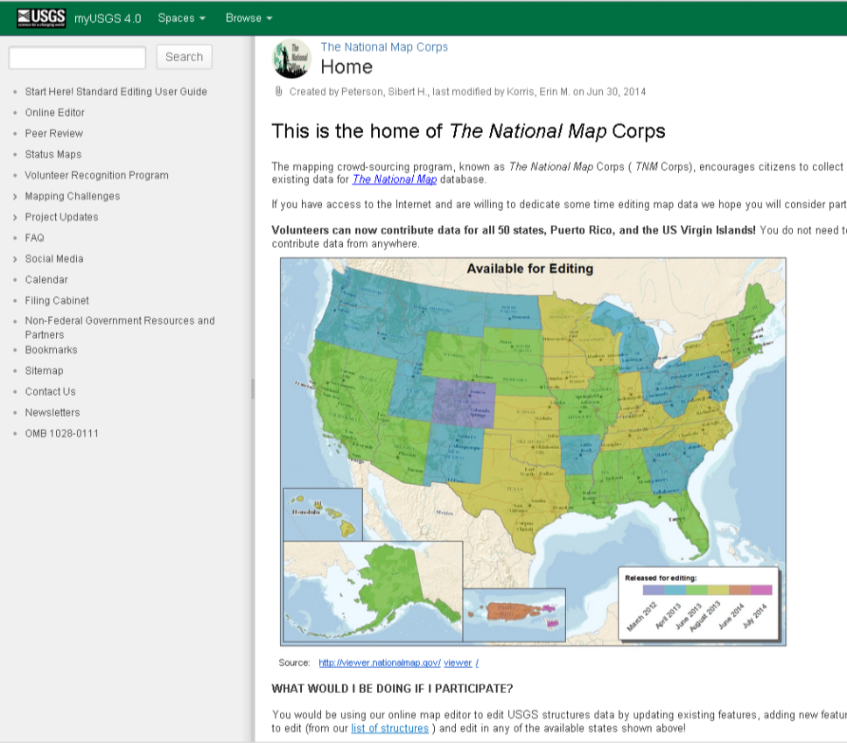
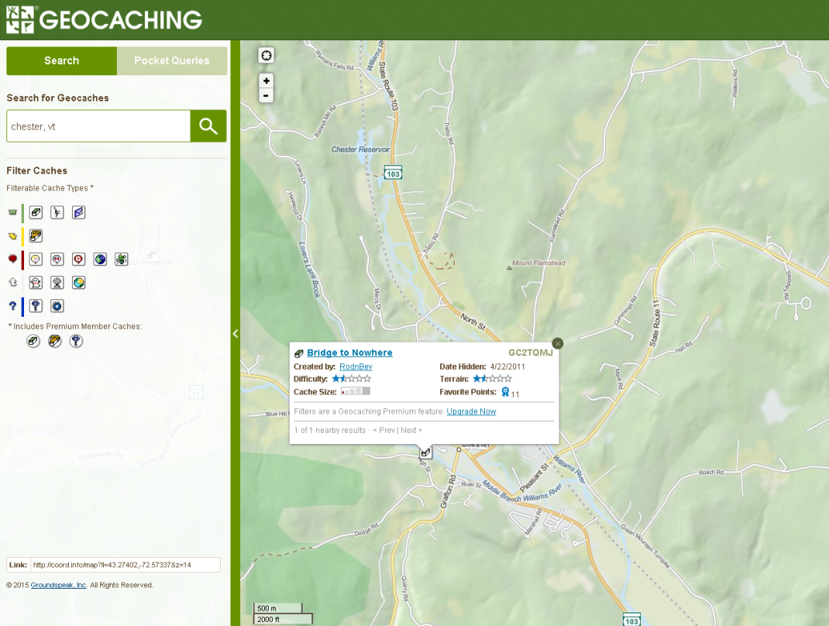
WHAT YOU CAN DO NOW

Slide 21
Stephen Smith
Rail GIS Project Supervisor

Slide 22
My Job
Enable the
Engineers
Property managers
Project managers
… in the rail section make use of geographic information through:
Data Design
Data Access
Data Maintenance

Slide 23
Some cool things
http://rail.vermont.gov/
http://vtransparency.vermont.gov/

Slide 24
Data and Policy
Policies come from data analysis
Needs authoritative data
GIS is the “system of record”
We are the stewards of that database

Slide 25
District General Manager Activity
Web Form: http://bit.ly/gmuhs
Dashboard: http://bit.ly/gmuhsdb

Slide 26
Additional GIS Info and Resources:
http://vtrans.github.io/chester-hs

Slide 27
QUESTIONS?
JOHNATHAN – NINA – STEPHEN vtrans.github.io/chester-hs/

